Slide 1





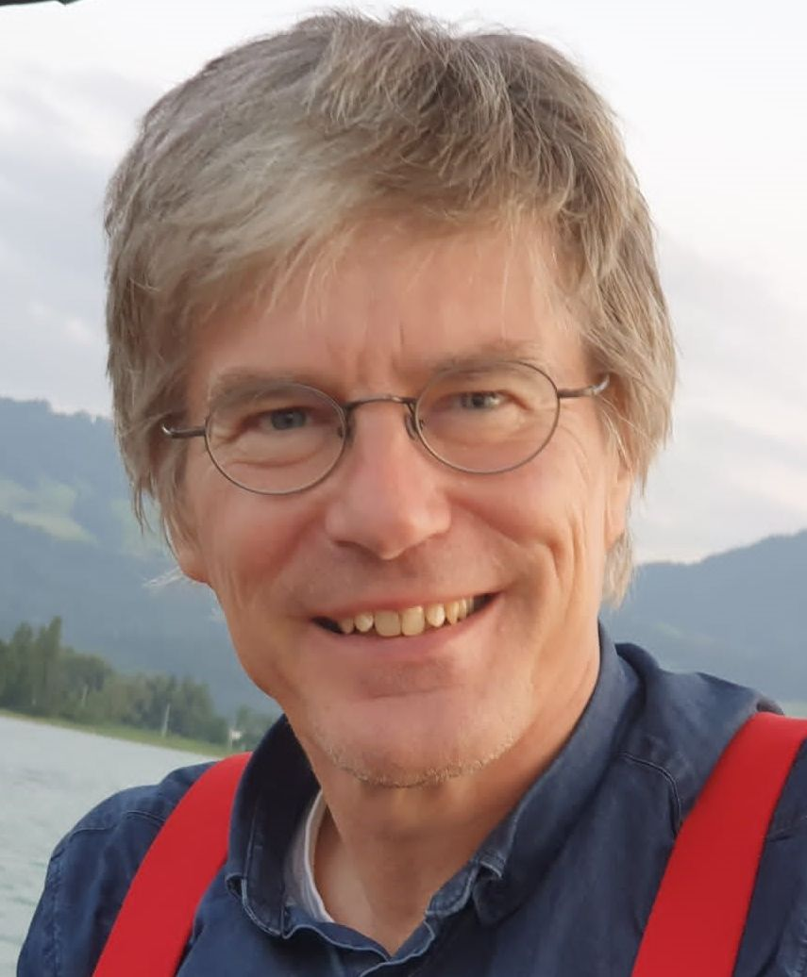



Michael Kauffeld
University: Karlsruhe University of Applied Sciences
Study program: Mechanical Engineering
Year of study: 43 years / 86 semesters
City: Karlsruhe, Germany
Motto for life: Faith moves mountains
Aging is mandatory, but growing up is optional
Hobbies: Sailing, skiing, hiking, bicycling, building wooden things, writing
Your expectations from the summer school:
Connect with many enthusiastic people
Together we make this world a better place
Location where I work,
and where I live 
Karlsruhe
31 August to 11 September 2026

